Slide 1
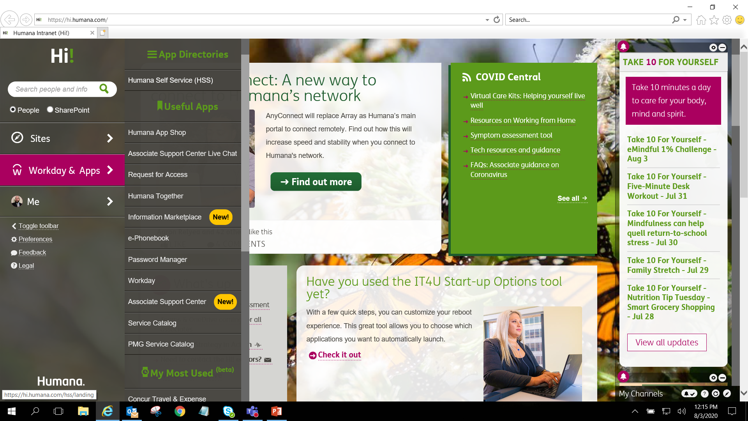
Hi Page
Workday & Apps
Humana Self Service (HSS)

Slide 2
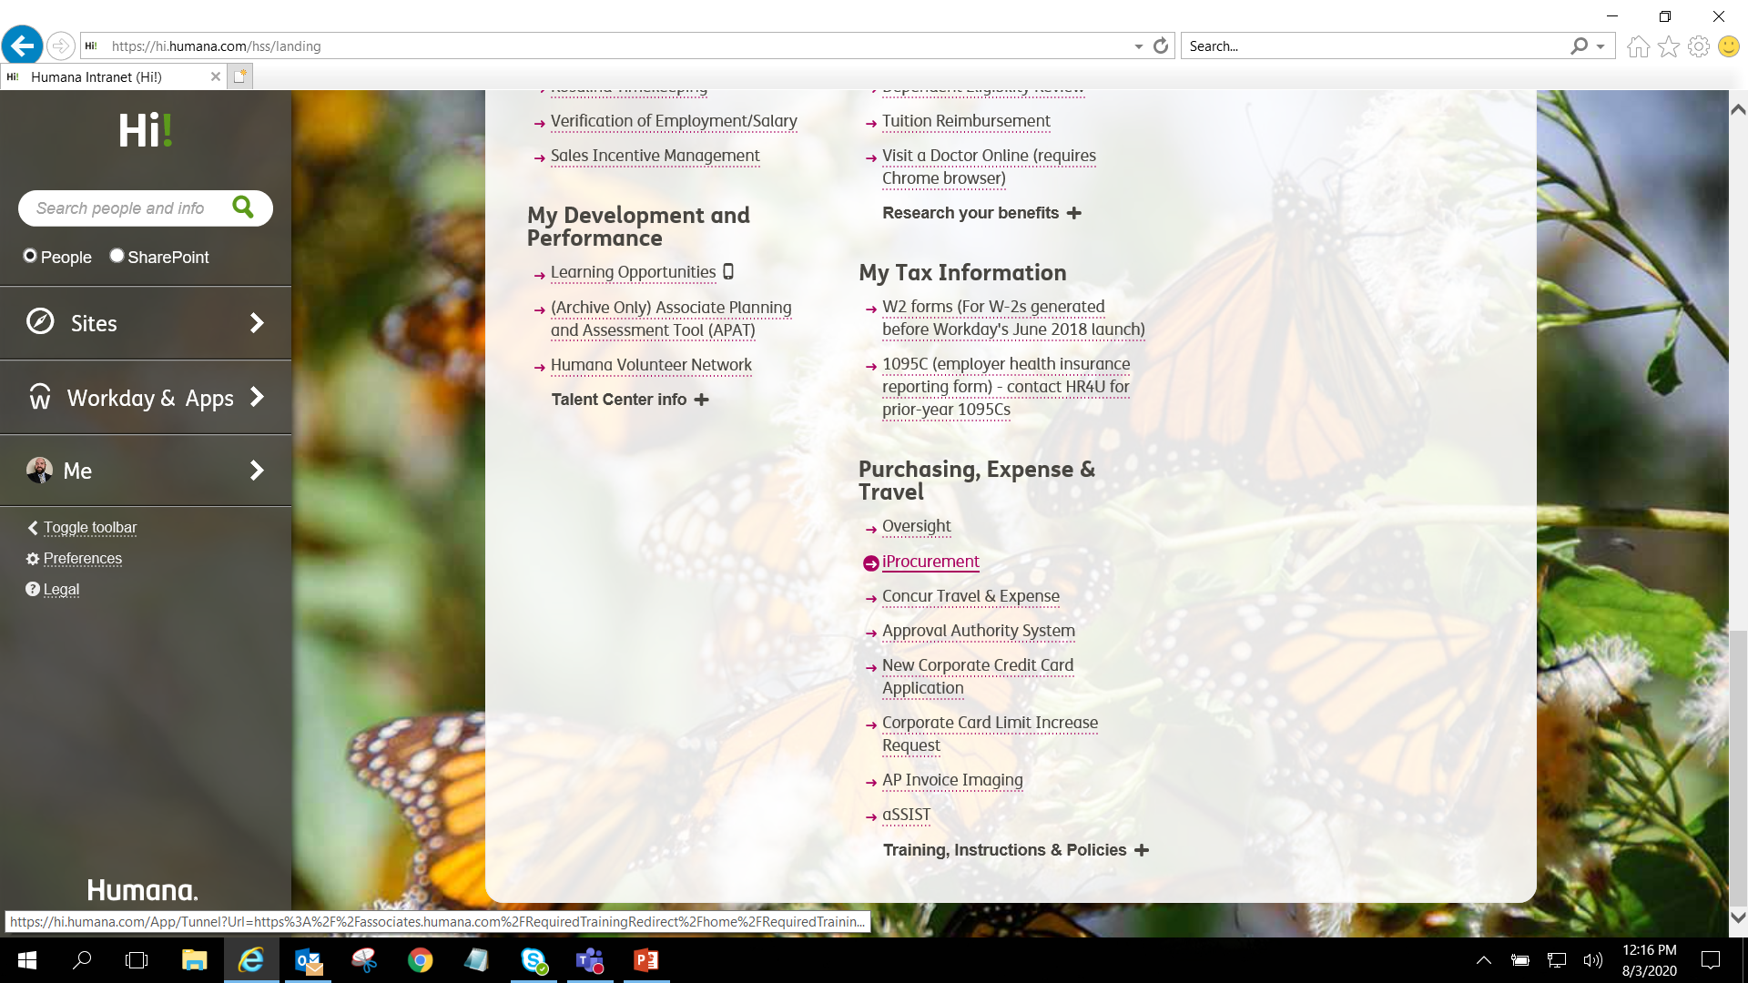
Click on IProcurement

Slide 3
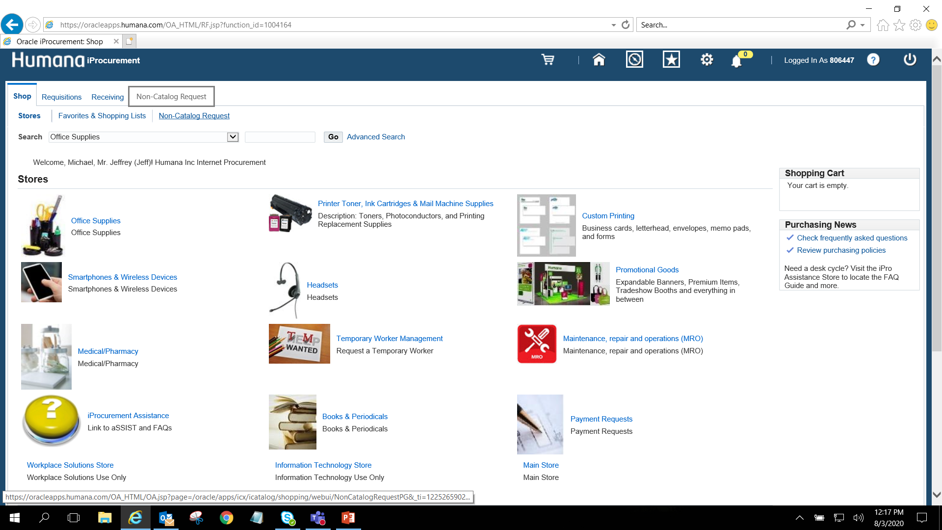
Click on Non-Catalog Request

Slide 4
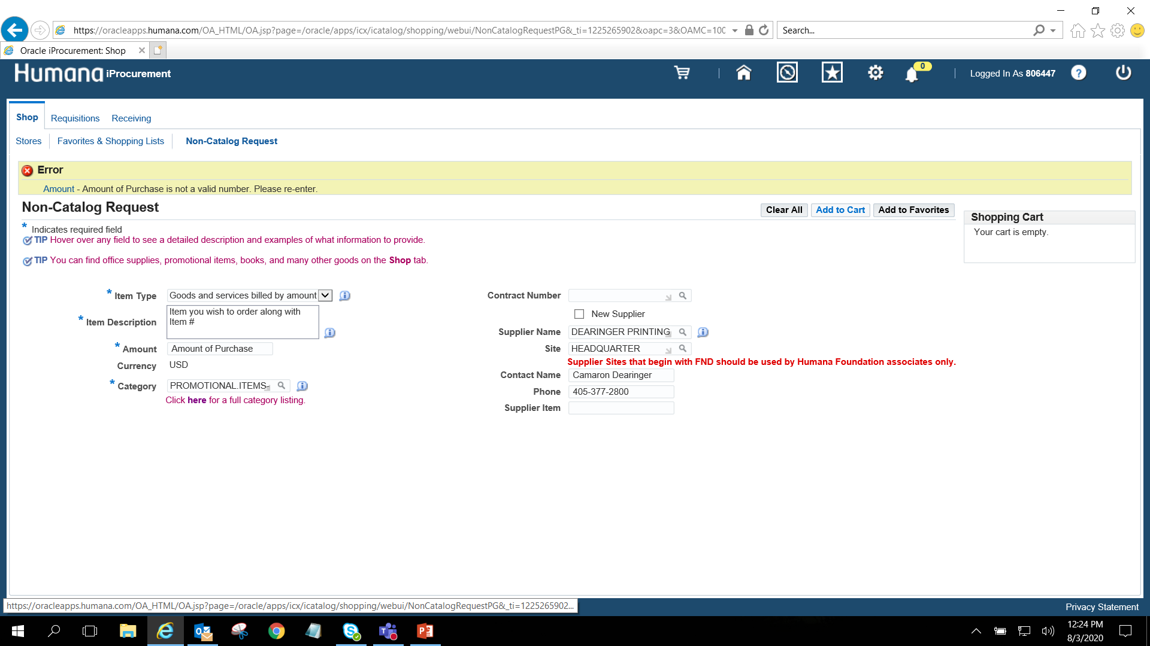
Supplier Name – type “4HEROS LLC” hit search
Site – Auto populates
Contact Name – Andy Hoffmann
Phone – 920-737-6595 (Andy’s Cell #)
Item Type – Goods and Services billed by amount
Item Description – Item Name, Item #
Amount – 4Heros can get this for you or use price list - Andy <andy.hoffmann@4heros.com>
Category – Promotional Items – Giveaways (type promo, hit search, select)

Slide 5
Add to Cart and checkout at next screen
This will route to Ed for approval

